Slide 1
ARES, Skywarn, NWS, and YOU
Cleveland County ARES Emergency Coordinator
Mark Kleine N5HZR – n5hzr@arrl.net

Slide 2
Vocabulary Lesson
Amateur Radio Emergency Service – ARES
American Radio Relay League – ARRL
National Weather Service – NWS
Norman Emergency Response Team - NERT
Oklahoma Medical Resource Corps – OKMRC
SKYWARN® – A program of the National Weather Service to collect local weather reports.
Storm Prediction Center – SPC

Slide 3
Amateur Radio Emergency Service® (ARES)
The Amateur Radio Emergency Service® (ARES) consists of licensed amateurs who have voluntarily registered their qualifications and equipment, with their local ARES leadership, for communications duty in the public service.
Currently online at http://aresok.org
Soon also to be online at http://aresconnect.org (maybe)

Slide 4
ARES Numbers
Total hams in Oklahoma as of 12/2018 – 9,801
Estimated active hams in Oklahoma – 5,500
Total registered with ARES-OK as of 12/2018 – 818
Most ARES members live along the I-44 corridor, as do 70% of our population

Slide 5
ARES – OK Training
Level | Description | Requirement
One | Entry Level or New to ARES | Attend ARES nets: Monday 8:15 pm DMR 3140 OK Statewide Tuesday 8:00 pm 147.06 MHz Sunday 2130 UTC - 4:30 pm CDT / 3:30 pm CST – 3.903 LSB – 7.260 LSB (conditions permitting) and NWS storm spotter training.
Two | Activation or Deployment | FEMA ICS 100, 200, 700, 800, and the ARRL EC-01 (emergency communications course). Volunteer for NERT / OKMRC
Three | ARES Leadership | Level Two; plus FEMA ICS 120, 230, 240, 241, 242, 244, 288. ARRL EC-16 (emergency Communications for Management) Leaders have one year to complete this training.

Slide 6
Hazards in Our Area
Fires
Flood
Bombing
Tornado
Train Accident
Utility Interruption
Communication System Interruption
And…???

Slide 7
Cleveland County ARES Customers
We serve a number of agencies in the area.
NWS
Norman Emergency Manager
Moore Emergency Manager
Newcastle Emergency Manager
Cleveland County Emergency Manager
American Red Cross

Slide 8
Cleveland County ARES Net
A net is opened when a client requests one, or when a controller believes it should start.
Net Controls operate from their house
Listen carefully to the net control operator
Use 147.06 – 146.88 – 443.7 in that order
Net control liaisons travel to their locations
Net control operator will manager the frequency. If you interrupt you’ll be given instructions. Don’t take it personally, just be aware of your surroundings.
About a half dozen local ARES folks monitor NWS activity through messenger client.
Typically, thunderstorm watches get attention
Tornado warnings in adjacent counties will start the net
Moderate and High Day 1 SPC items keep the teams busy

Slide 9
Cleveland County ARES Liaisons
The Norman Emergency Operations Center is manned by David Grizzle and is staffed by ARES volunteers Bill Lockett, Doug Forsyth, and Don Parker.
The Moore Emergency Operations Center is operated by Gayland Kitch and Debbie Wagner.
The Newcastle Emergency Operations Center is operated by Jon Tankersley and Steve Venz. Jon is looking for volunteers to staff that facility.
The Cleveland County Emergency Operations Center is managed by George Mauldin.
The National Weather Service forecasters monitor WX5OKC and their proprietary application.
Blanchard “Y” lead spotter

Slide 10
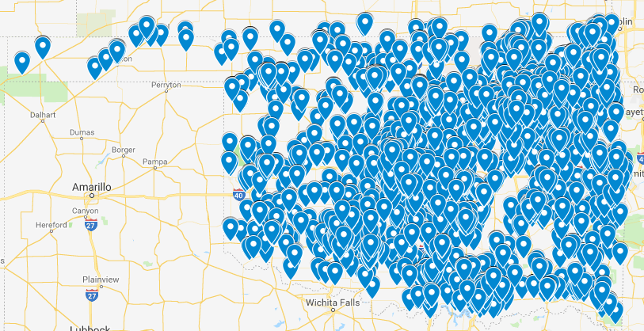
Oklahoma Hams

Slide 11
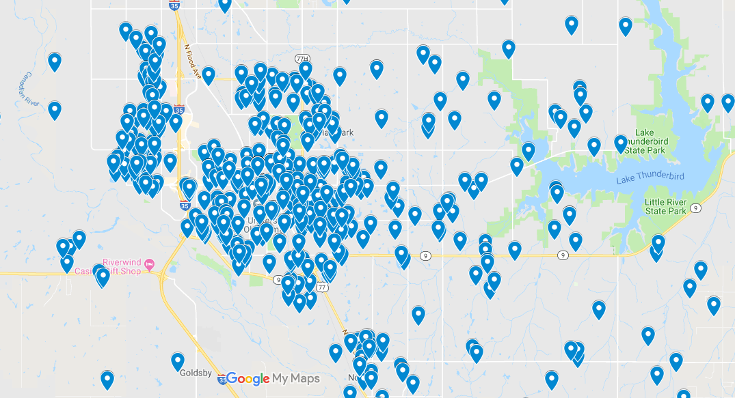
Cleveland County Hams

Slide 12
Cleveland County Trained Spotters
Hams that have had the proper FEMA training.
Have attended a NWS training last year, or the previous year.
Documentation should be filed with Mark Kleine, EC.
ARES Training available for viewing at https://w5nor.org/arestrain
We use a spot in place technique.
Trained spotters are first tier responders during nets.
Spotter comments are relayed via NWS messenger.

Slide 13
Cleveland County Reliable Sources
These are second tier responses.
Usually respond to net control requests.
Used to report damage and conditions as the storms move through.
Hopefully all of you in the room.

Slide 14
“Storm Chaser” vs. “Storm Spotter”
Storm Chasers are usually “lone wolf” people that are out for thrills, or entertainment.
Storm Spotters are usually working with ARES groups, or local Emergency Management operations.
Spotter Network is a group that issues numbers to verify your reports made through that organization. For example, mine is 52709.
https://www.spotternetwork.com
I’ve never used my spotter number because we report directly to the NWS.
Storm Spotters never self-deploy, they work with groups like ARES.

Slide 15
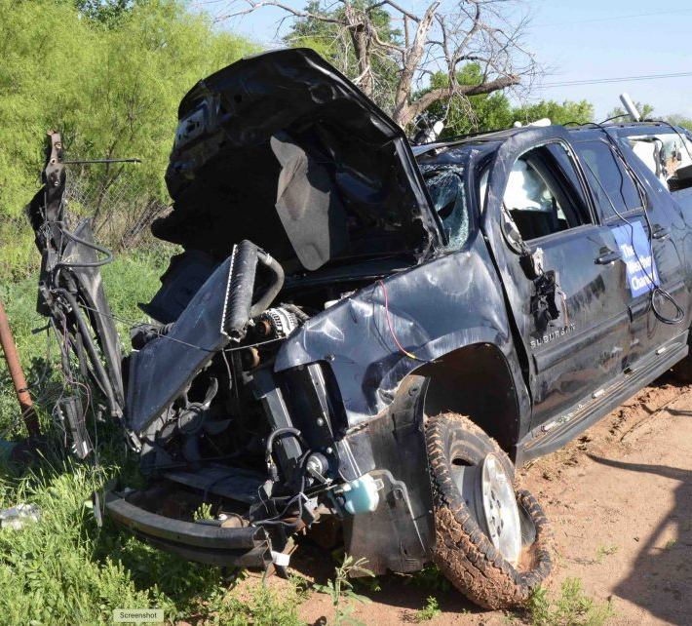
This is the Outcome of a Bad Chase
$125 million dollar lawsuit against the Weather Channel
While live streaming
Blew through a stop sign
70 mph t-boning another
Killed 2 in this truck, and one in the other vehicle.
This was their fourth violation of the day.
In 14 videos – 80 stop sign violations, 5 red lights

Slide 16
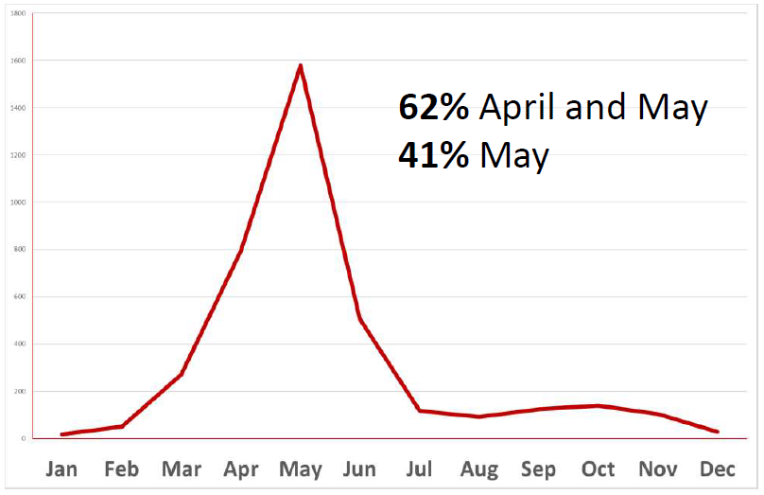
OK Tornadoes by Month
Tornadoes happen in every state
Tornadoes happen in every month
However, April, May, and June is definitely our busy season

Slide 17
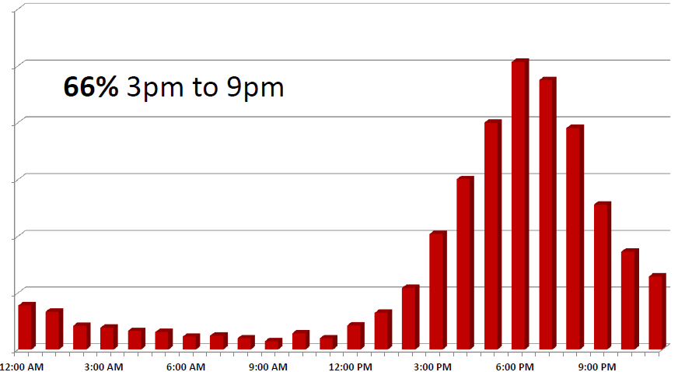
OK Tornadoes by Time of Day
Tornadoes can happen at any time
However, 66% happen during drive time, dinner time, and prime time
Keep aware on danger days and keep watching the 1, 2, 3+ outlooks

Slide 18
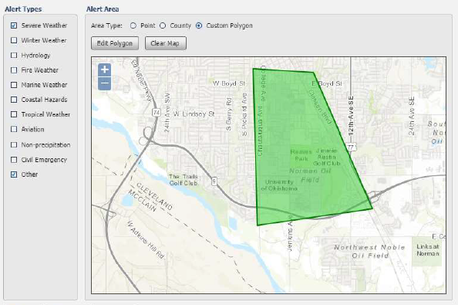
NWS Alerts
NWS has experimental push alerts to advise watches, warnings, and more
Selection areas can be a county, or a polygon as shown
For EM / Media

Slide 19
Emergency Managers Updates
General updates are Monday morning
Additional updates are provided as required
During dangerous situations, these are daily

Slide 20
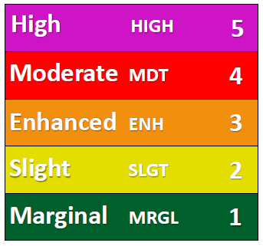
Storm Prediction Center - SPC
SPC outlooks are issued at set times and are not updated in between
WFO Norman’s outlook graphics may be slightly different from SPC at times. For example…
Shifting risk area lines to include entire counties or metro areas
Combining adjacent similar risk areas
Updated WFO outlook before SPC scheduled updates
A higher risk somewhere else doesn’t reduce your risk
DAY 1 Today
DAY 2 Tomorrow
DAY 3 Day after tomorrow
DAY 4-8 3-7 days from today

Slide 21
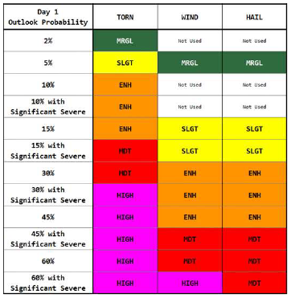
SPC Math to English
This is for Day 1 reports
Other charts relate Day 2+ reports

Slide 22
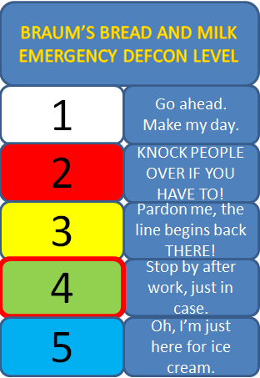
Braum’s Response to SPC Day 1 Reports

Slide 23
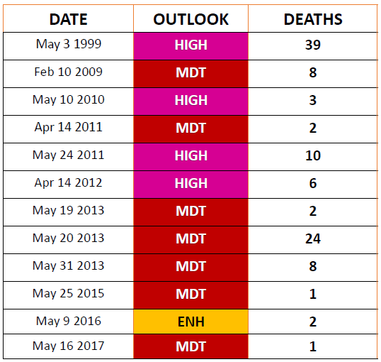
Killer Tornadoes in OK
OUTLOOKS (day 1) on 12 KILLER TORNADO DAYS
HIGH 4
MDT 7
ENH 1

Slide 24
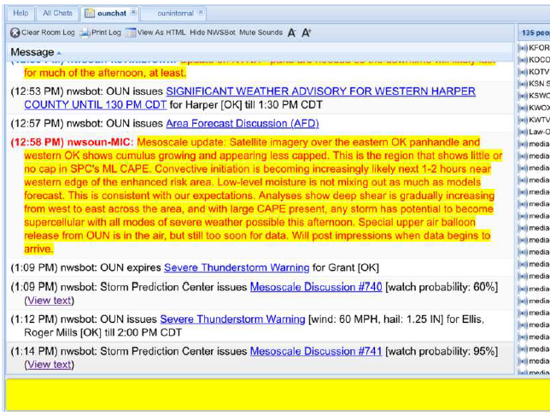
EM / Media / NWS Messenger
On severe weather days there are 150+ Emergency Managers, Media, and NWS people online
Typically, the NWS posts their explanation of an upcoming warning or watch before it is actually issued
CC ARES has a half dozen on this list during storms
Direct channel into the NWS

Slide 25
w5nor.org/weather spc.noaa.gov

Slide 26
SPC Update Schedule – Day 1
ISSUED 5 TIMES A DAY
1:00 AM CDT
8:00 AM CDT
11:30 AM CDT
3:00 PM CDT
8:00 PM CDT

Slide 27
SPC Update Schedule – Day 2
ISSUED 2 TIMES A DAY
1:00 AM CDT
12:30 PM CDT
SPC Update Schedule – Day 3
ISSUED 1 TIME A DAY
2:30 PM CDT

Slide 28
General Warning Philosophy – NWS Norman
Default warning duration for SVR and TOR is 45 minutes
Warnings as small as possible to cover the storm(s)
They try to account for city and county boundaries
Warning polygons will likely overlap at times
Automated Outdoor Warnings Systems will sound on each of these overlapped areas

Slide 29
NWS Reporting Criteria – Report on Net During the Storm - Hail/Wind/Flooding
Hail especially 1 inch (quarter size) or larger (NO marbles…)
Wind measured or estimated 60 MPH or higher
Damage any damage caused by wind or hail
Flooding
street flooding
water high enough to prompt road closures
water getting into (or close to) structures
any water rescues
any reports of stranded/trapped people

Slide 30
NWS Reporting Criteria – Report on Net During the Storm – Tornado
Wall Cloud/Funnel Cloud/Tornado
1st or 2nd hand reports from trusted source
details on WHEN, WHERE and viewing location
Damage
any damage thought to be from tornado

Slide 31
NWS Reporting Criteria – Report on Net After the Storm
DAMAGE
ANY damage to:
home/mobile home
business/factory
school/athletic facilities
church
barn/shed/outbuilding
vehicles
fences
trees/limbs/branches
irrigation rigs
power poles/lines

Slide 32
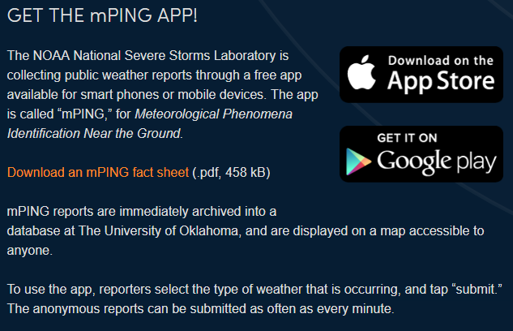
mping.nssl.noaa.gov

Slide 33
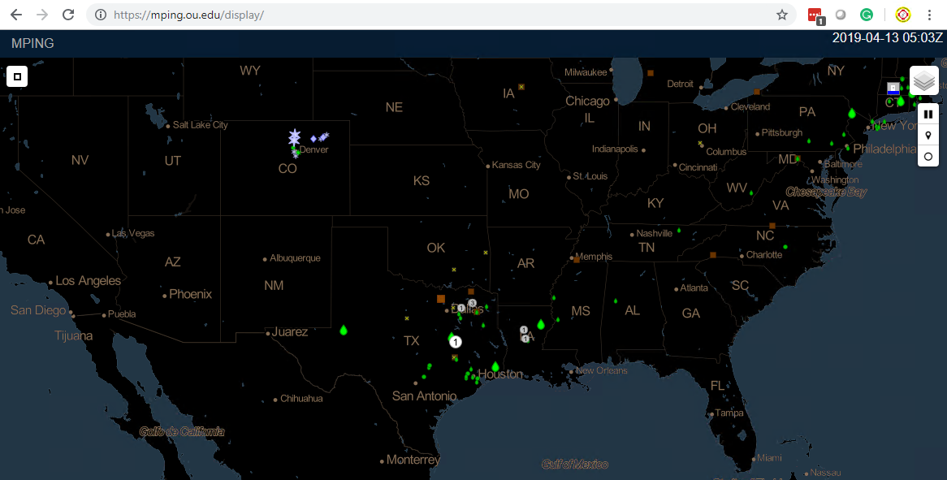
mPing Display

Slide 34
It’s all about YOU Watching the Weather – Radar Sources
Windows
Gibson Level 3 (about $80)
Android
RadarScope
MyRadar
Apple IOS
RadarScope
MyRadar
Storm Radar

Slide 35
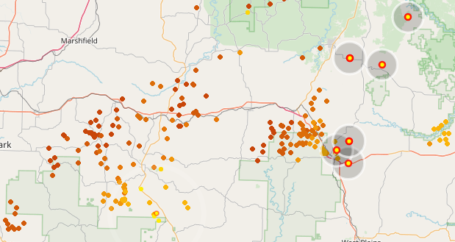
It’s all about YOU Watching the Weather – Other Sources
Lightning Maps
https://www.lightningmaps.org

Slide 36
Thank You Mr. Skaggs WB5ULK

Slide 37
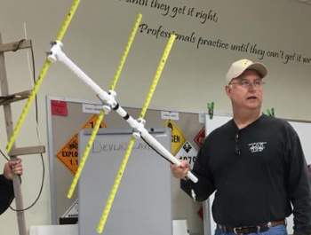
Are YOU Ready? QRV?
Battery powered radios?
Lightning safe antennas?
Charged Phone?
Battery lighting?
Medicine?
Water?
Go-Bag?
Go-Box?

Slide 38
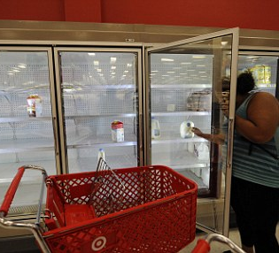
Don’t Be This Guy
And, don’t be the guys that pillages the shelves
Why buy perishables right before you may lose power?
Have food on hand that won’t go bad.
Got peanut butter?

Slide 39
How Can You Stay Involved?
Keep watching the weather
Watch the Storm Predication Center. https://w5nor.org/weather
Be Careful how you watch TV – Even the NWS is calling out these guys
Always have a Safe Location planned out.
Listen to 147.06 or online at https://w5nor.org/listen
Watch your weather sources – computers / phones / tablets
Get mPing, use it to report what you see

Slide 40
ARES, Skywarn, NWS, and YOU
Cleveland County ARES Emergency Coordinator
Mark Kleine N5HZR – n5hzr@arrl.net

